Slide 1
Bus Ticketing System

Slide 2
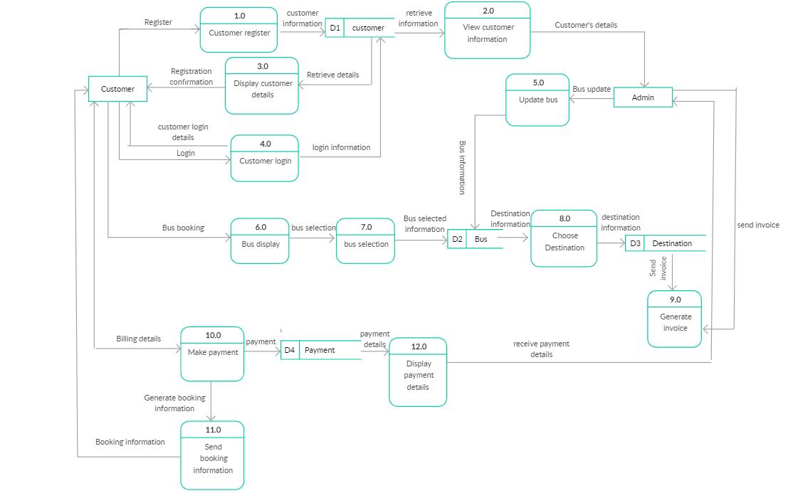
Bus Ticketing System – Data Flow

Slide 3
Backend Data-Model in Salesforce
BUS Trips
Traveler [Standard Contact]
Fields | Data Type
Name | Auto-number
Source | Picklist
Destination | Picklist
Trip date | Datetime
Seats | Multi-select picklist
Trip Status | Picklist
Price | Text
Fields | Data Type
Name | Text
Address | Picklist
Phone Number | Number
Payment Method | Datetime

Slide 4
Backend Data-Model in Salesforce
Bookings [Junction Object]
Transaction Details
Fields | Data Type
Name | Auto-number
Bus Trip | Master Detail (Bus Trips)
Traveller | Master Detail (Traveller)
Trip date | Datetime
Booked Seats | Multi-select picklist
Transaction Number | Lookup (Transaction Details)
Fields | Data Type
Transaction Id | Auto-number
Amount | Number
Date of Transaction | Datetime
Status | Picklist
Error Notes | Text Area

Slide 5
Integration with Payment Gateways
I will take an example of integrating Salesforce with Paypal as a payment gateway.
Below are the steps:
1.)In Develop | Security | Remote Site Settings Add https://api-3t.sandbox.paypal.com (For Sandbox). You need to get the Endpoint URL where the request is to be sent. 2.) Get the Paypal Sandbox Credentials for account (http://developer.paypal.com) You will need a.)Seller Account Username Password Api Signature b.)Buyer Account
You need to get the credentials for the services you want to consume. Now as you have all the ground work done lets move to the implementation of the Apex code for integration. Now From The Api of the Service you want to integrate get the details of the Mandatory variables ie :Paypal(Do Direct Payment Api)

Slide 6
Integration with Payment Gateways
After you set the variables as per the Api now you need to send the http request to the paypal server. Http httpObject = new Http(); HttpRequest req = new HttpRequest(); String url = 'https://api-3t.sandbox.paypal.com/2.0/'; string un = 'Your Username'; string pw = 'Your Password'; string sig = 'Your Signature'; string soapXML='Here soapXMl is the request String in XML format'; req.setBody(soapXML); req.setEndpoint(url); req.setMethod('POST'); req.setHeader('Content-length', '1753' ); req.setHeader('Content-Type', 'text/xml;charset=UTF-8'); req.setHeader('SOAPAction',''); Now Send The Request HttpResponse res = httpObject.send(req); String xml = res.getBody(); The result will be an xml which can be parsed using XmlStreamReader Now read the XML response and get the Paypal result XmlStreamReader reader = res.getXmlStreamReader(); result = readXMLResponse(reader,'Ack');

Slide 7
Integration with Payment Gateways
Similarly in the same way, we can integrate with other endpoints like UPI etc.

Slide 8
Tech Stack to be Used
LWC – Lightning Web Component
Angular JS for UI
Apex Controller (Server Side connection)
Data Model (Objects and fields as mentioned above)
Integration Layer (using Rest API)
Community
Triggers, Process builders etc

Slide 9
UI for Bus Ticketing Application
Login/Signup screen – When the user enter details, contact will be created with customer community user license, using which they can access bus ticketing application and make transactions.
.

Slide 10
UI for Bus Ticketing Application
First Screen – The user can enter source and destination and datetime of travel and all available buses will be displayed.

Slide 11
UI for Bus Ticketing Application
Second Screen – All available buses will be queried from the database and displayed on UI according to the source ,destination and datetime of travel selected.

Slide 12
UI for Bus Ticketing Application
Third Screen – Seat Select screen.

Slide 13
UI for Bus Ticketing Application
Fourth Screen – Payment Options screen.
After selection and clicking ‘Pay’ button, Make a callout to payment provider ( as mentioned in integration section) with mentioned details and amount.
Based on response, show success, or try again message to user.

Slide 14
Push Notification in case of Cancellation of Bus Trip
We will use Salesforce Native Event based architecture where we will be publishing event as soon as status of booking is changed to cancel.
External systems can subscribe to the platform event and as soon as event is published in the event bus, all the external systems will be notified.

